Slide 1
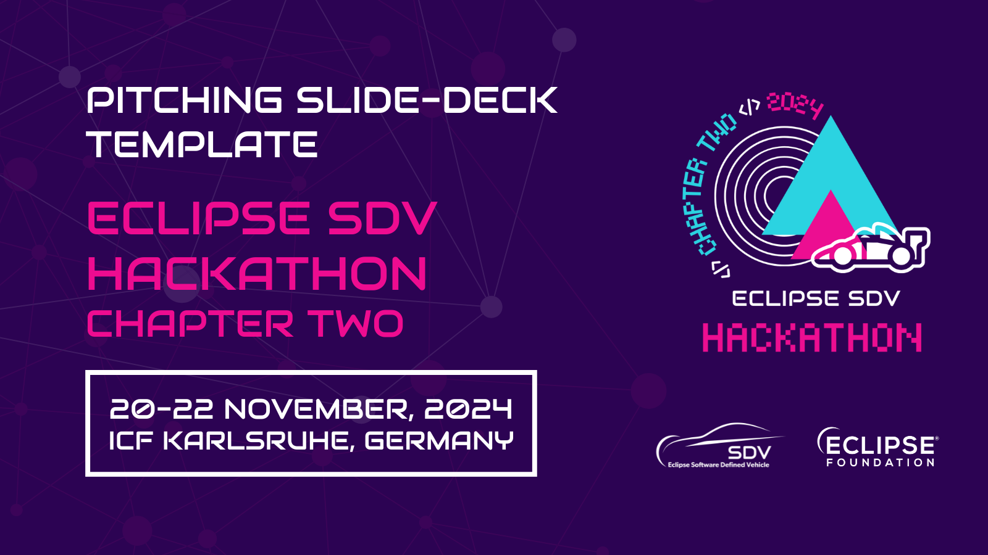

Slide 2


Pitching Session
Challengers
20-22 November, Karlsruhe, Germany
An Eclipse SDV Event

Slide 3
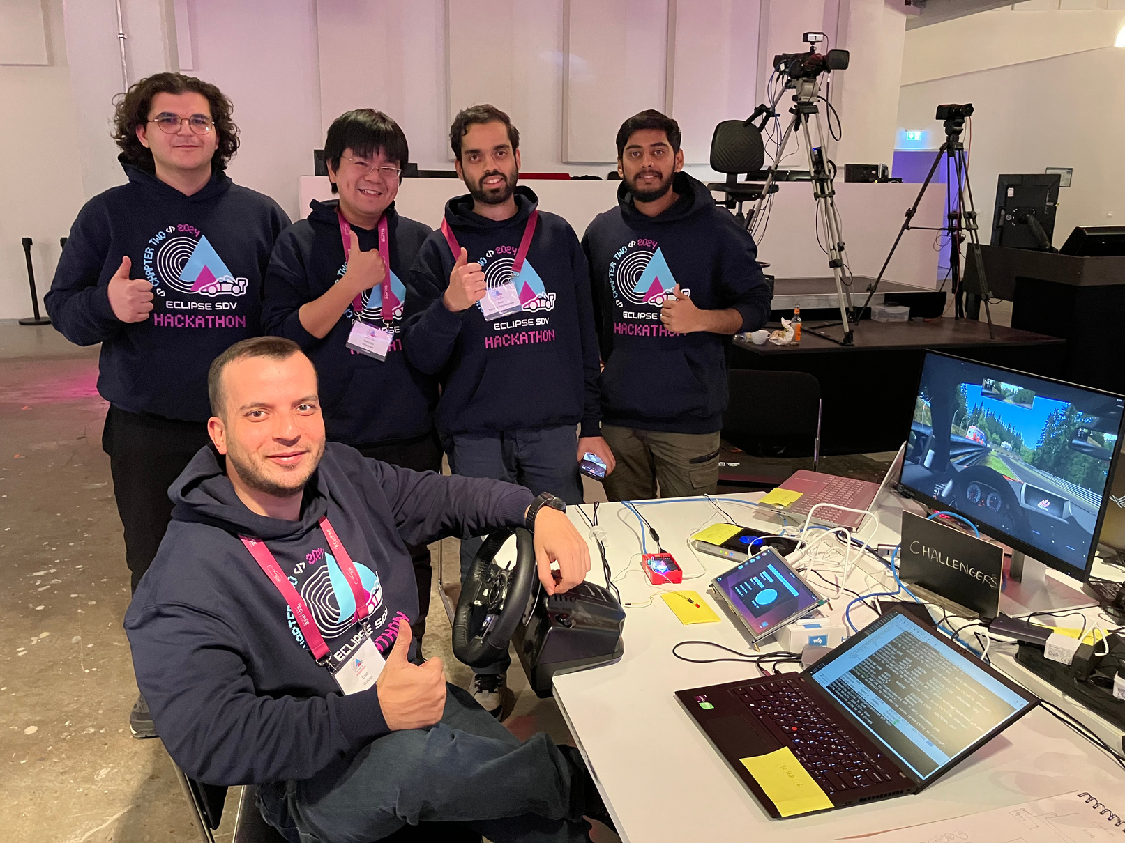
The Team
Chinmay Srinivas
Esat Gulkaya
Kamel Fakih
Likhith Sadahalli Thammegowda
Motohiro Shibakawa

Slide 4


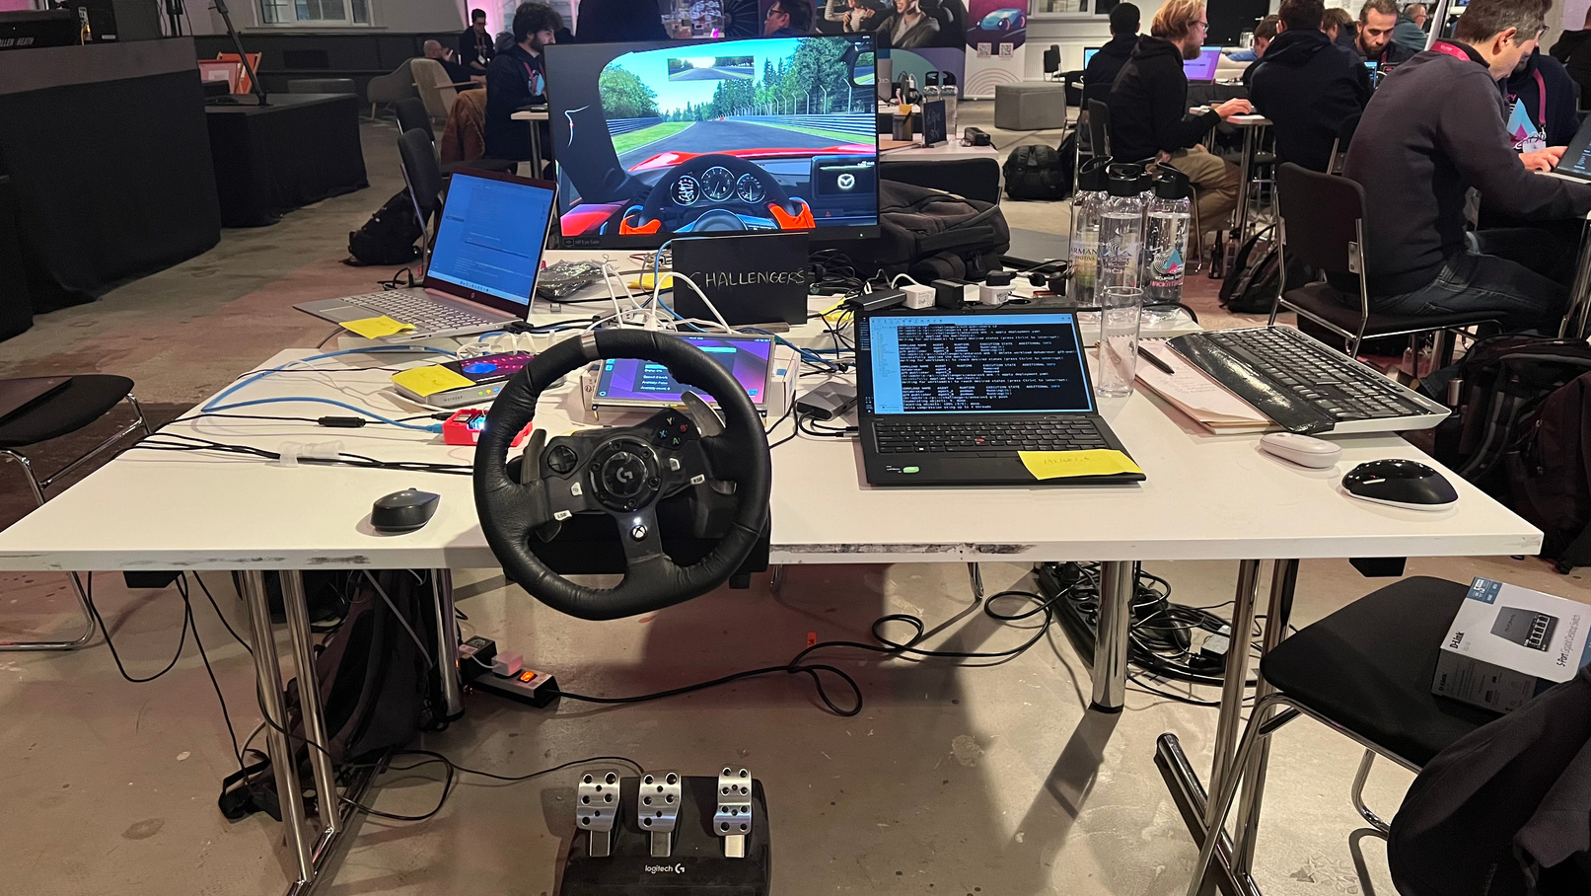
What did we do?
A platform that collects and processes data from a vehicle's input devices, such as a steering wheel, to control in-game vehicles and evaluate driver behavior.
This system can be applied across various industries, including education, training, and insurance.
20-22 November, Karlsruhe, Germany
An Eclipse SDV Event

Slide 5
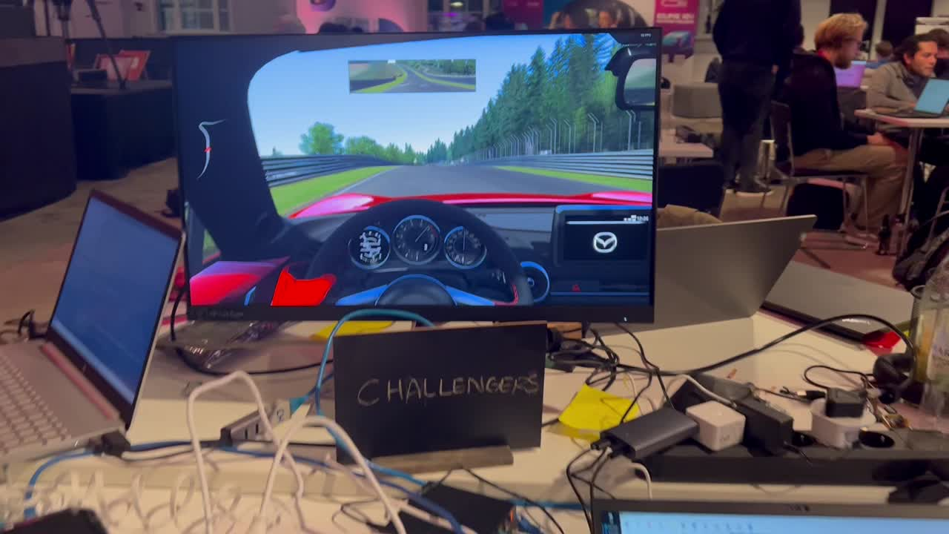
How we did it?

Slide 6


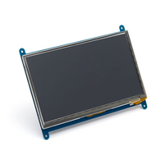
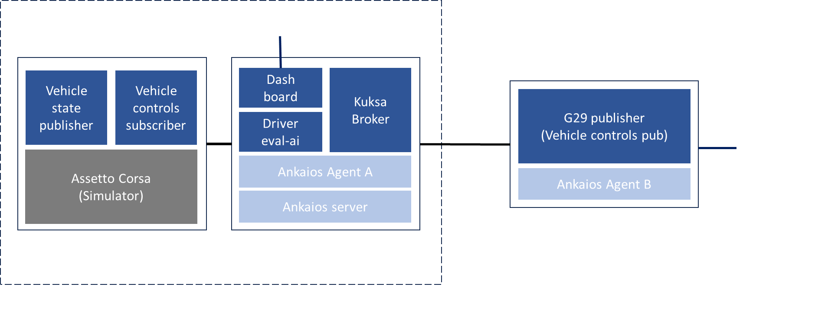
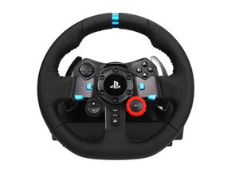
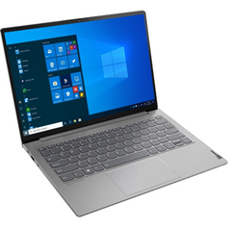
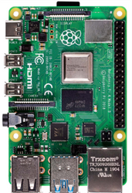
System Architecture

Slide 7

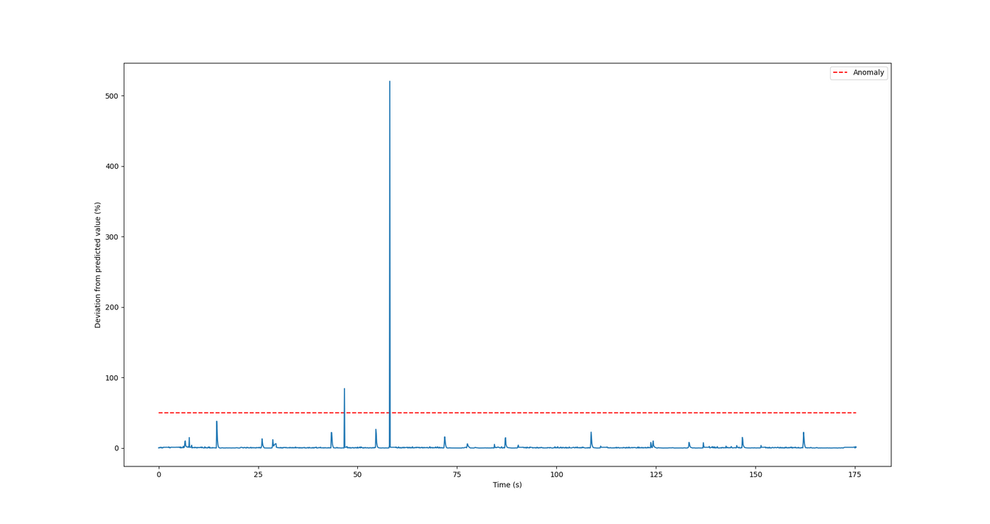
Anomaly Detection
An anomaly detector to improve drivers’ driving skills.
Uses pre-trained ML model to detect unusual activity such as harsh braking.

Slide 8
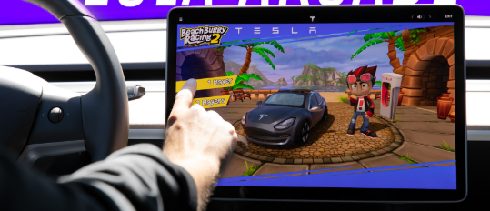
The Market & Competition
Market
Individual drivers
Driving schools & F1 academies
Insurance companies
Fleet managers
Competition
Tesla
Daimler Fleet Management GmbH

Slide 9
Business Model
Subscription-Based Model:
Monthly or yearly plans for access to the platform.
Basic Plan: Individual users for skill improvement.
Enterprise Plan: Businesses like driving schools, insurers, or fleet managers.
Pay-Per-Use:
Charge businesses based on the number of driver assessments processed.
White-Label Solutions:
Offer the platform to insurance companies or driving schools for rebranding.
Data Licensing:
Sell anonymized driving data to researchers or automotive companies.
Integration Fees:
Custom API integration with gaming platforms or other enterprise software.

Slide 10
Business Plan
Partnerships:
Collaborate with driving schools, insurance providers, and gaming platforms.
Freemium Model:
Offer a basic version for free with paid premium features like advanced analytics and detailed reporting.
Pilot Programs:
Work with insurance companies and driving schools to showcase the platform’s value in real-world scenarios.
Industry Events:
Present at automotive, insurance, and gaming expos to attract early adopters.
Digital Marketing:
Leverage online advertising targeting driving schools, insurers, and gamers.

Slide 11
Thank You!
Questions?
20-22 November, Karlsruhe, Germany
An Eclipse SDV Event

